Slide 1
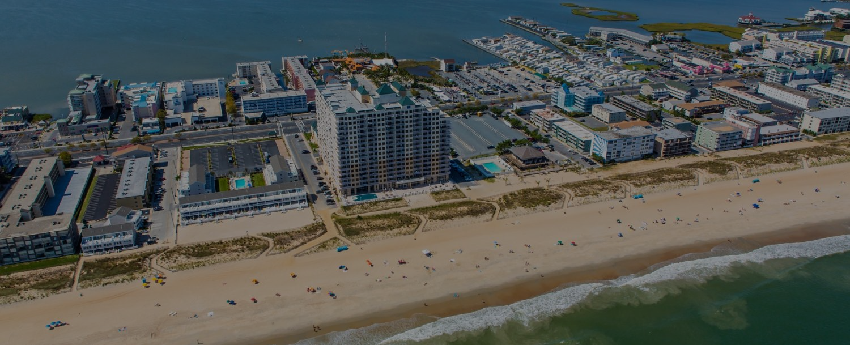
“MILES OF SMILES”
Delivering a Consistent Customer Experience in Ocean City, Maryland
June 3, 2025

Slide 2
Welcome to Ocean City
Get to know Ocean City, MD, and our neighboring towns with this intro video from Visit Maryland’s Coast Worcester County.

Slide 3
Attitude
The longer I live, the more I realize the impact of attitude on life. Attitude, to me, is more important than the past, than education, than money, than circumstances, than failures, than successes, than what other people think or say or even do. It is more important than appearance, giftedness or skill. It will make or break a company…a church…a home. The remarkable thing is we have a choice every day regarding the attitude we will embrace for that day.
We cannot change our past… we cannot change the fact that people will act in a certain way. We cannot change the inevitable. The only thing we can do is play on the string we have, and that is our attitude. I am convinced that life is 10 percent what happens to me and 90 percent how I react to it. And so it is with you…we are in charge of our attitudes!
-Charles Swindoll

Slide 4
All Aboard The Blue Train
No way!
Can’t be done!
We’ve done this before!
Yes we can!
Why the heck not?
Can’t hurt to try
Endless Possibilities
Blah,
Blah,
Blah
(–)
(+)
Destination:
Nowhere
Destination:
Ocean City!

Slide 5
Three Economies
Price
Experience
Convenience

Slide 6
Four Reasons People Buy
Brand: 19%
Product: 19%
Price: 9%
Experience: 53%

Slide 7
Where Have All The Customers Gone?
1% - Died
3% - Moved away
4% - Naturally float
5% - Change on a friend’s recommendation
9% - Can buy it cheaper somewhere else
10% - Are chronic complainers
68% - Go elsewhere because their expectations were not met
(Even because of one person’s attitude!)

Slide 8
It’s Easy
A Perfect Product
Delivered By A Caring Friendly Person
In A Timely Manner
With World-Class Problem Resolution

Slide 9
Four Human Needs
1. Welcome
2. Understood
3. Comfortable
4. Important

Slide 10
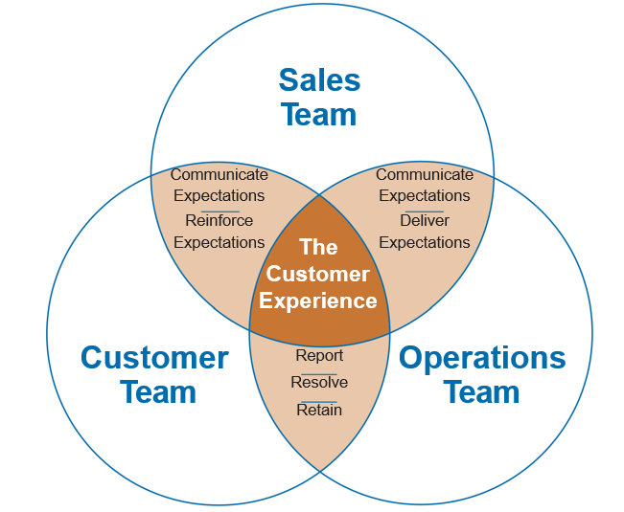
Customer Experience Playbook

Slide 11
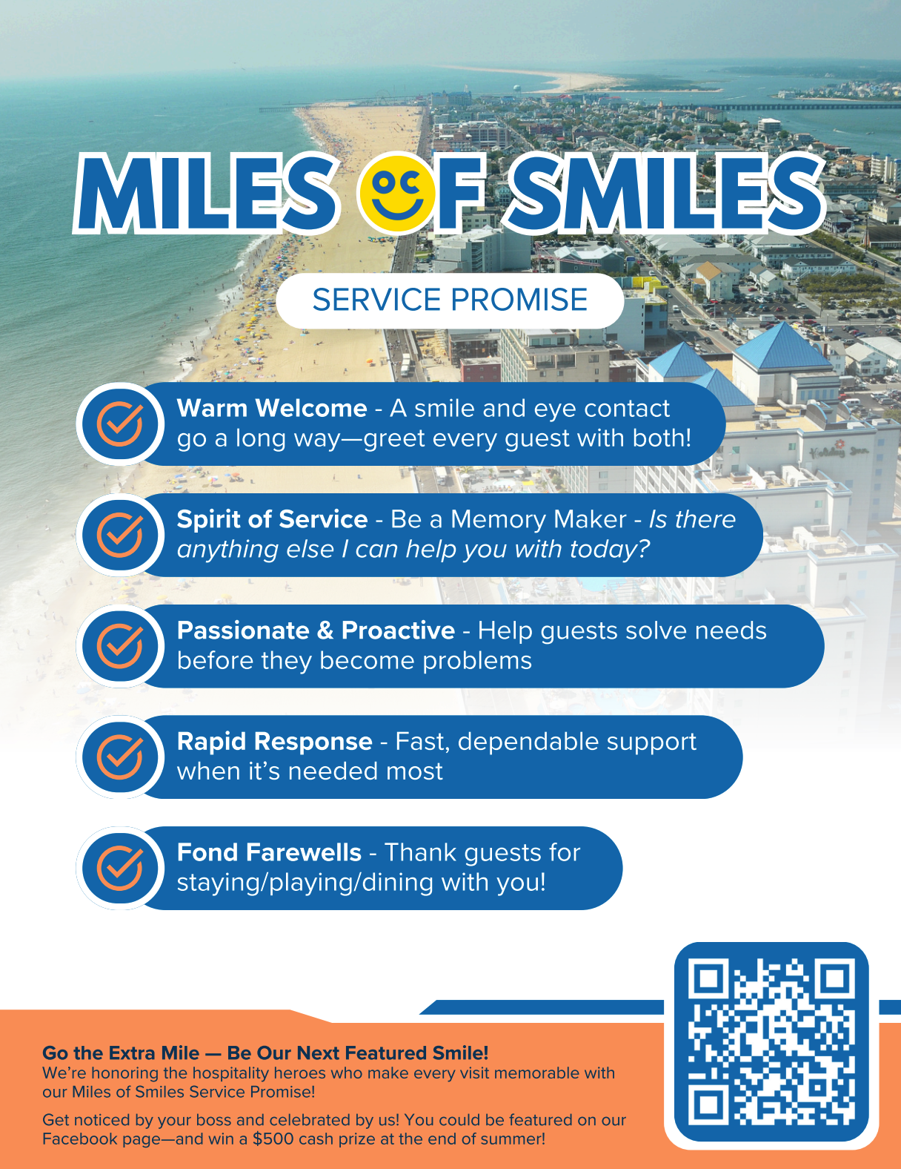
Our
Service Promises

Slide 12
Hospitality Language
How may I help…
Let me suggest…
I’d like to ask you…
It’s my pleasure…
We appreciate your business
Thank you…You’re welcome
I’d be happy to…
The Answer Should Always Be
“YES!”

Slide 13
“Line Of One Culture”
The ability to create a solid and unified force of people and energy…focused on accomplishing the same mission.

Slide 14
Miles of Smiles Will Set
Ocean City Apart!

Slide 15
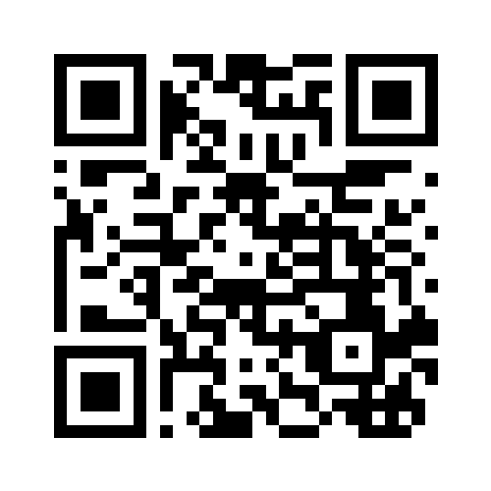
PEOPLE
PROCESS
Strategic Planning
Executive Coaching
Workplace Culture
Keynote Speaker
Training Videos
On-Boarding Systems
Attraction / Retention
Team Engagement
Data Analytics
Intranet Platforms
Digital Scoreboards
Benchmarking
CEO Dashboards
Workplace Applications
Website / E-Commerce
Business Efficiencies
john@boomerwrangle.com
(443) 605 - 7095

